Slide 1

Introduction to Frontend Engineering
Oluwasetemi Ojo and Desmond Nyamador

Slide 2

Lesson Outline
Building Blocks
Tools (Vscode Introduction)
Introduction to HTML
Building out our first html page
Semantic HTML
Limitations of HTML
Emmets
Introduction to
Frontend Engineering (HTML)

Slide 3


Slide 4
Introduction to Frontend Engineering
Building Blocks

Slide 5
Hyper Text Markup Language (HTML)
Cascading Style Sheets (CSS)
Uniform Resource Locators (URLs)
Hypertext Transfer Protocol (HTTP and HTTPS)
JavaScript Programming Language (ECMAScript)
Document Object Model (DOM)
Others include: DNS - Domain Name System, Web Browsers, Web Servers and Web Hosting, Internet (Understanding how internet works)

Slide 6
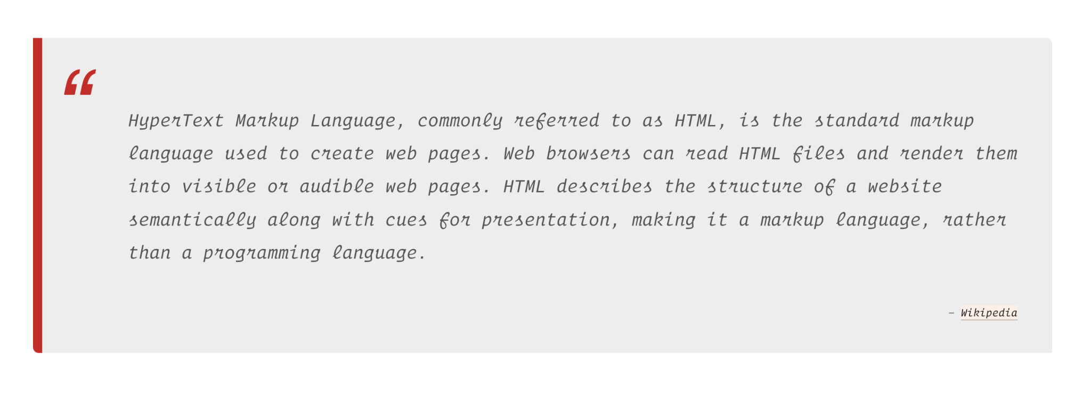
Building Blocks

Slide 7
Introduction to Frontend Engineering
Tools

Slide 8

Visual Studio Code
Download VS code
Get familiar with VS code Interface
Install the Live Server Extension
Install the Prettier Extension
Important tips and tricks
Know and learn important shortcuts, Windows or Mac OS
PS: Change the look and feel of your vscode with themes, install any preferred theme from the marketplace.

Slide 9
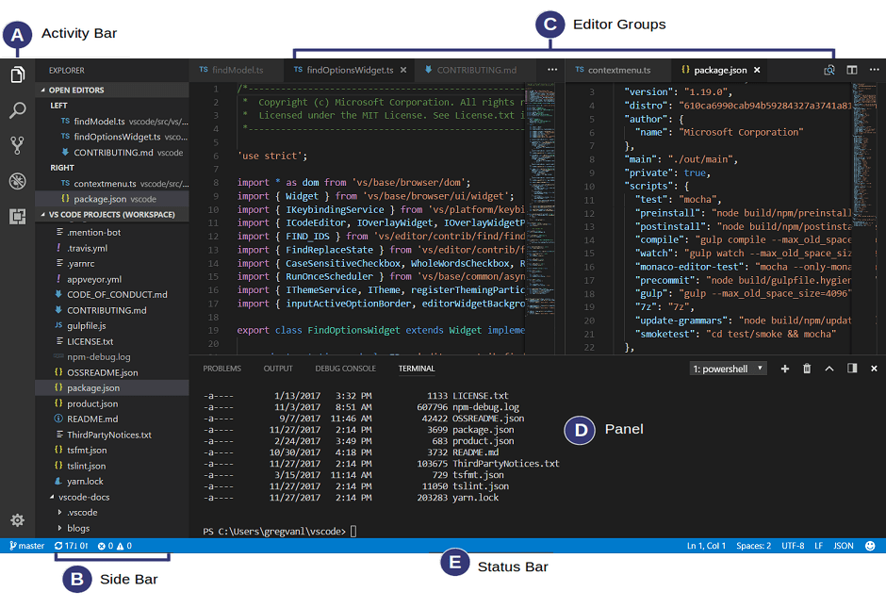

Slide 10
Introduction to Frontend Engineering
Getting Started with HTML

Slide 11
Getting Started with HTML
Few important things to note:
Basic Structure
Element or Tags
Opening and Closing Tags
Self closing Tags
Inline or block Tags
Meta tags
Attributes
name=”value”
Single value attribute
Reference for more about HTML Tags
MDN HTML reference
HTMLreference.io
Introduction to Frontend Engineering

Slide 12
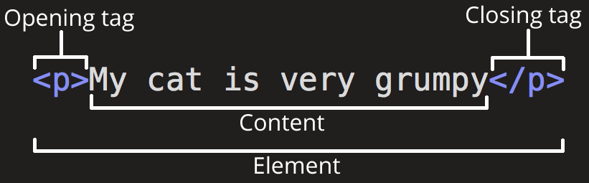

Slide 13
Exploring HTML Tags
Few important tags to note:
h1 to h6
p, em, i, a, blockquote, sub, sup,
ol, ul, dl, datalist
Img, video, audio
table, tbody, thead, tr, th, td
form, input, select, button, textarea, fieldset
div, span, link, style, meta, title, details, head, body, html
For more on HTML Tags
MDN HTML reference
HTMLreference.io
Introduction to Frontend Engineering

Slide 14
Introduction to Frontend Engineering
Building our first HTML page

Slide 15

Building our first HTML page
Introduction to Frontend Engineering
Let’s get our hands dirty with code.

Slide 16

Building our first HTML page
Introduction to Frontend Engineering
Open VScode and build something awesome

Slide 17
Introduction to Frontend Engineering
Semantic HTML

Slide 18
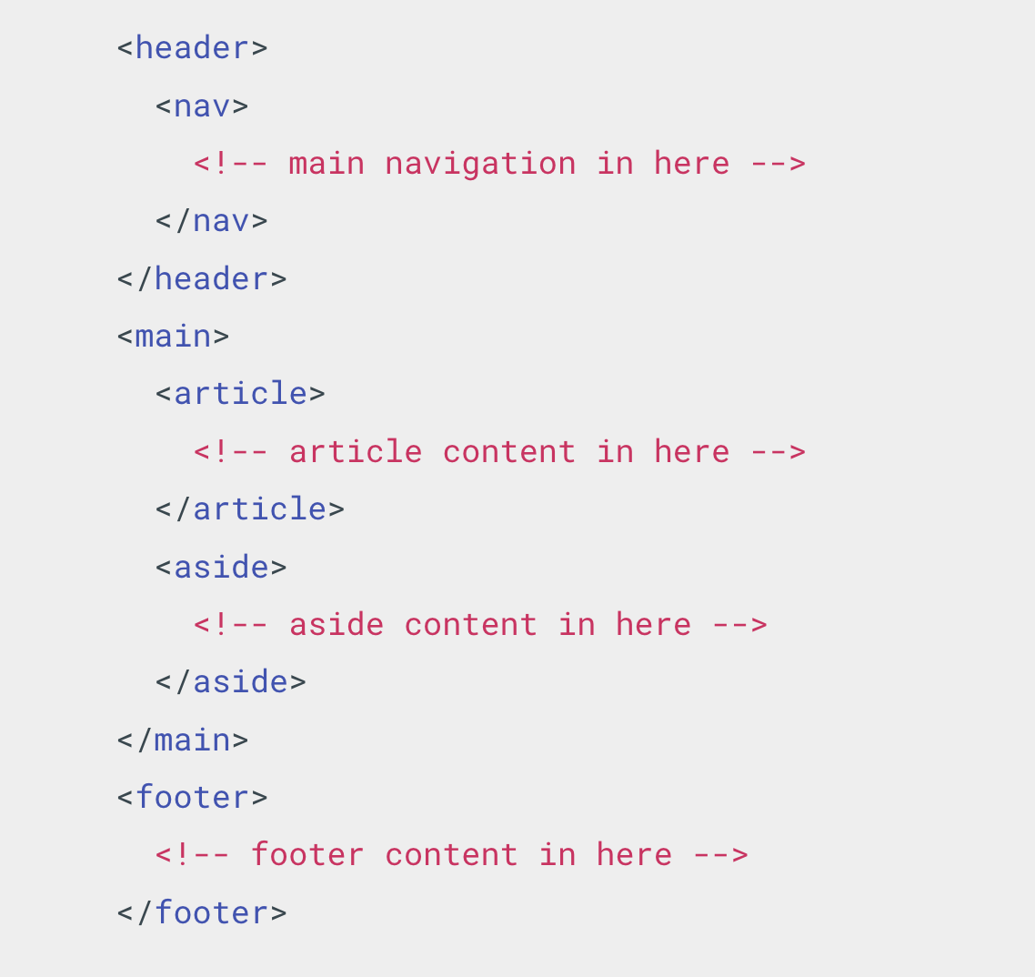
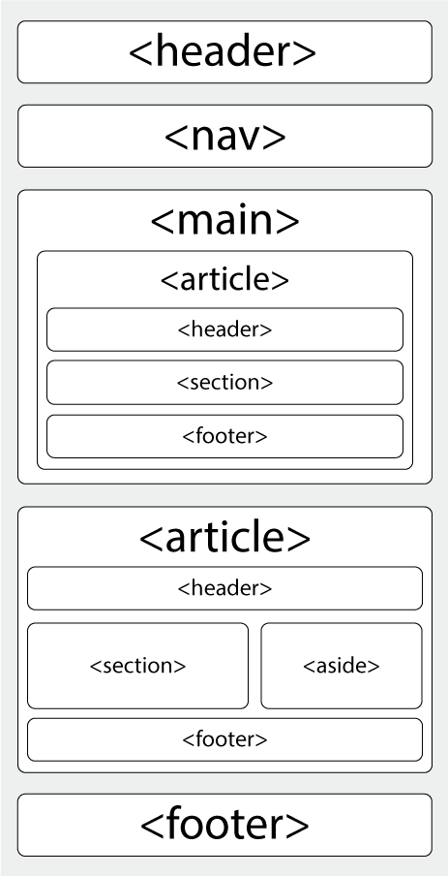

Slide 19
Semantic HTML
header
main
article
aside
section
footer
figure
mark
figcaption
time
nav
Introduction to Frontend Engineering

Slide 20
Introduction to Frontend Engineering
Limitations of HTML

Slide 21
Limitations of HTML
You can not create dynamic content
It has limited designing capabilities
Syntax errors are not identified or displayed by HTML
Any type of calculations can not be done in HTML
You can not create interactive web pages with HTML
Complex HTML code is hard to read and understand
Introduction to Frontend Engineering

Slide 22
Introduction to Frontend Engineering
More Practical on HTML

Slide 23
Introduction to Frontend Engineering
Emmets

Slide 24
Emmets
Abbreviations - #page>div.logo+ul#navigation>li*5>a{Item $}
Syntax - class, id, siblings, child, climb up and multiplication
Let stop here for now. For more information check the documentation.
Introduction to Frontend Engineering

Slide 26
Let’s talk about CSS
Cascading Style Sheets

Slide 27
Lesson Outline
CSS Basics
Syntax
Selectors
Adding CSS to HTML
Styling HTML pages
CSS Variables and Comments
Play CSS Game
Emmets
Introduction to
Frontend Engineering (CSS)

Slide 28
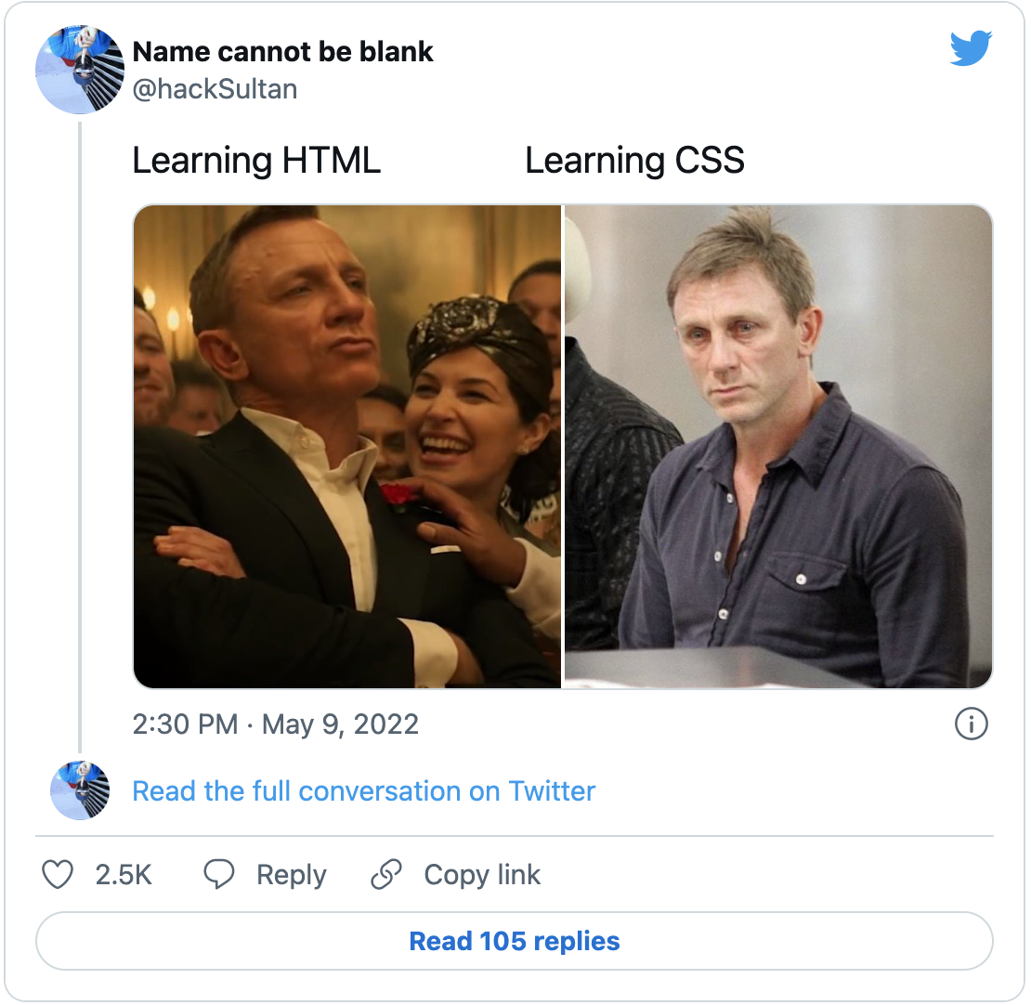

Slide 29
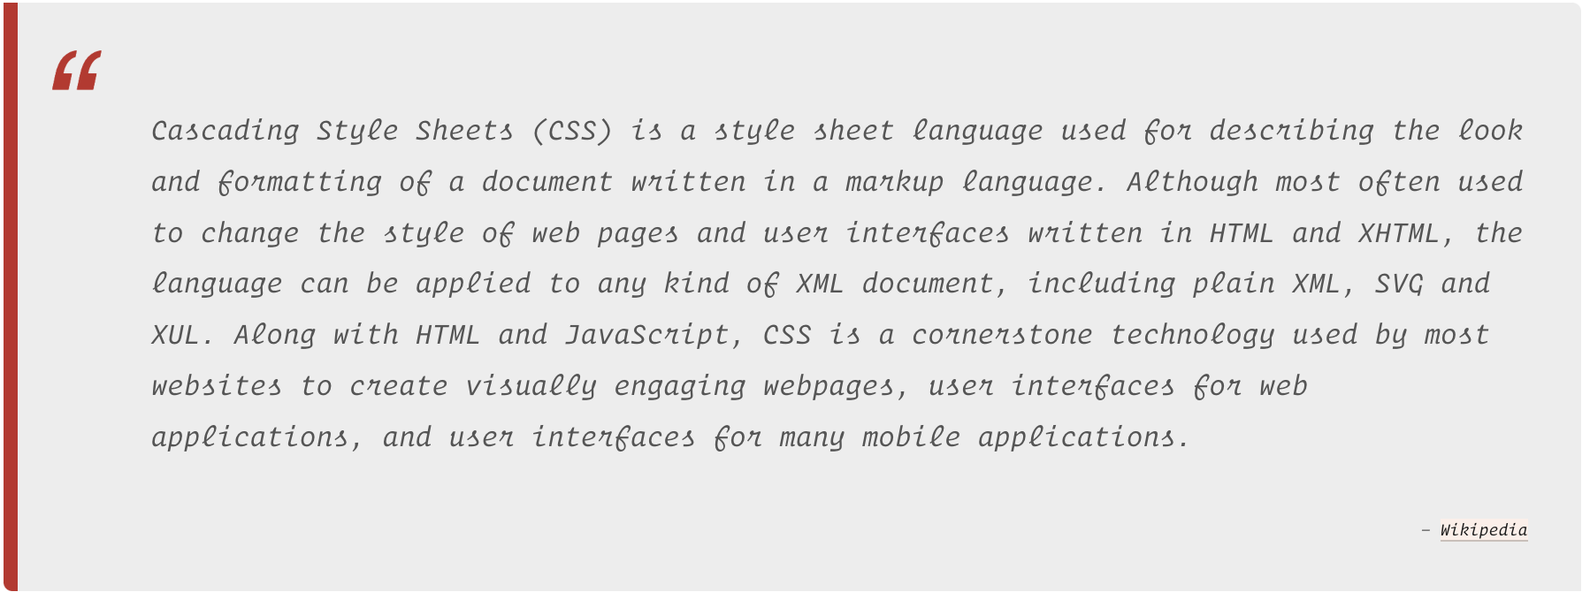

Slide 30
CSS Basics
selectors
rule set
curl braces {}
properties
values
adding css to html
specificity
cascading
Introduction to Frontend Engineering

Slide 31
Introduction to Frontend Engineering
CSS Syntax

Slide 32
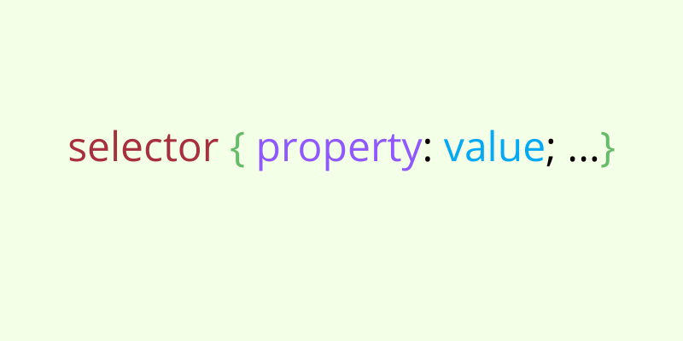

Slide 33
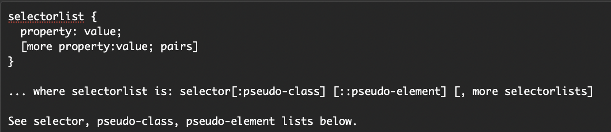
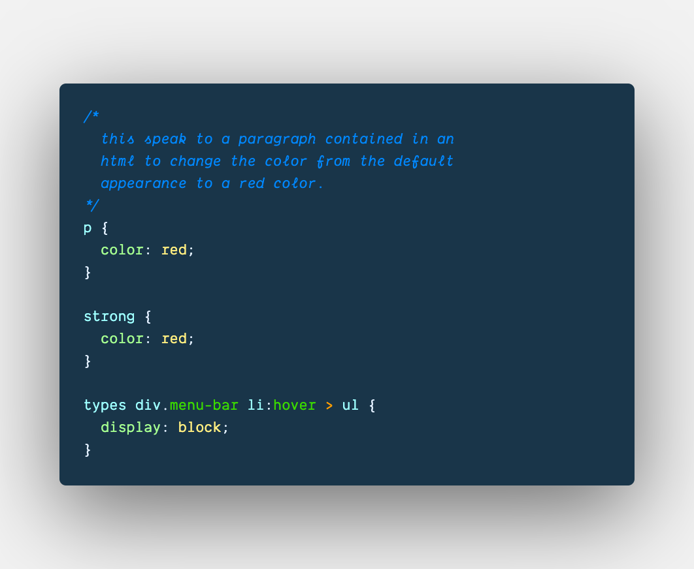
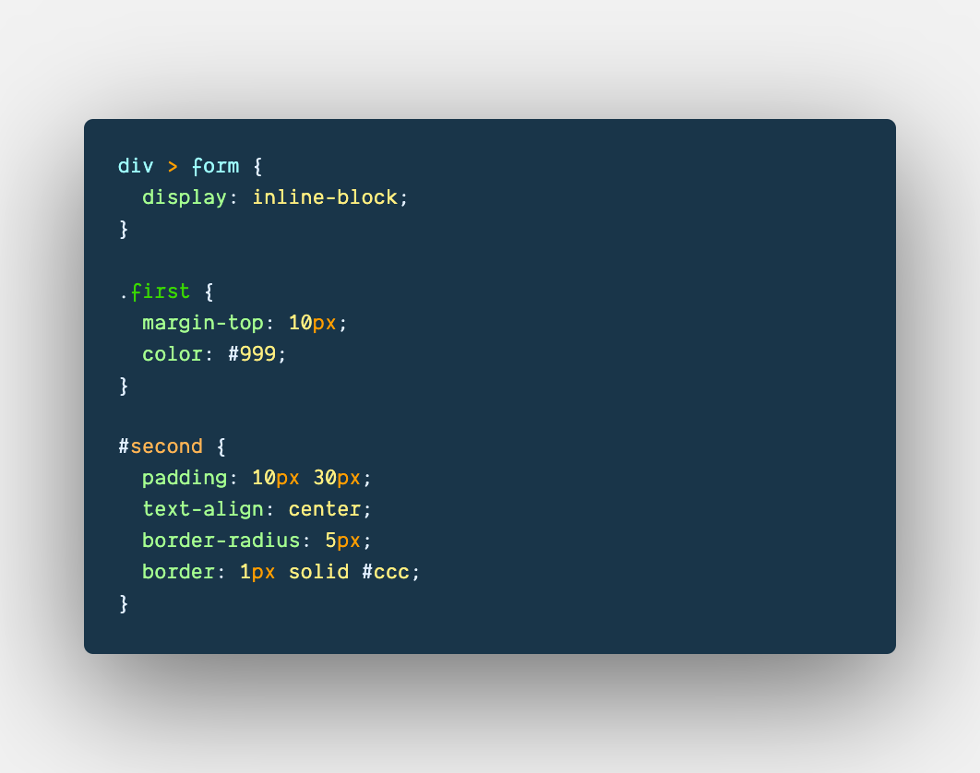

Slide 34
Introduction to Frontend Engineering
CSS Selectors

Slide 35
Type selector - p { }
id selector - #id { }
class selector - .class {}
universal selector - * {}
descendant selector - div p {}
child combinator - ul > li {}
adjacent sibling - div + p {}
general sibling - div ~ p {}
attribute selector img[src]
pseudo class :class
pseudo element ::first

Slide 36
CSS - Specificity, Inheritance and Cascading
Rules to Note on Specificity
Universal selector (*), combinators (+, >, ~, '') and negation pseudo-class (:not()) have no effect on specificity. (The selectors declared inside :not() do, however.)
Inline styles added to an element (e.g., style="font-weight:bold") always overwrite any styles in external stylesheets, and thus can be thought of as having the highest specificity.
ID selectors are highly specific.
Class selectors, attributes selectors and pseudo-classes are less specific compared to ID selectors and Inline styles.
Type selectors and pseudo-elements.

Slide 37
More on CSS Specificity
The amount of specificity a selector has is measured using four different values (or components), which can be thought of as thousands, hundreds, tens and ones — four single digits in four columns:
Thousands: Score one in this column if the declaration is inside a style attribute (such declarations don't have selectors, so their specificity is always simply 1000.) Otherwise 0.
Hundreds: Score one in this column for each ID selector contained inside the overall selector.
Tens: Score one in this column for each class selector, attribute selector, or pseudo-class contained inside the overall selector.
Ones: Score one in this column for each element selector or pseudo-element contained inside the overall selector.
The image in the next slide shows a few isolated examples to get you in the mood. Try going through these, and making sure you understand why they have the specificity that we have given them.

Slide 38
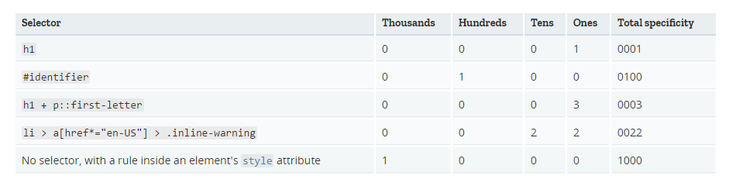
More on CSS Specificity

Slide 39
CSS Cascade
The cascade is an algorithm that defines how to combine property values originating from different sources. It lies at the core of CSS, as emphasized by the name: Cascading Style Sheets.
The CSS cascade algorithm's job is to select CSS declarations in order to determine the correct values for CSS properties.
The cascading algorithm determines how to find the value to apply for each property for each document element:
It first filters all the rules from the different sources to keep only the rules that apply to a given element. That means rules whose selector matches the given element and which are part of an appropriate media at-rule.
Then it sorts these rules according to their importance, that is, whether or not they are followed by !important, and by their origin. The cascade is in ascending order, which means that !important values from a user-defined style sheet have precedence over normal values originated from a user-agent stylesheet.
In case of equality, the specificity of a value is considered to choose one or the other.

Slide 40
Introduction to Frontend Engineering
Adding CSS to HTML

Slide 41
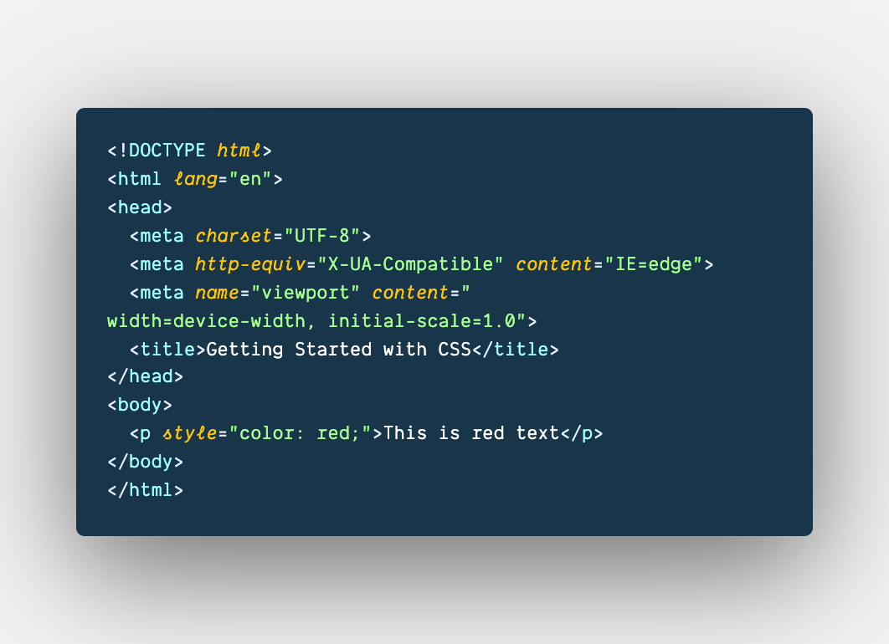
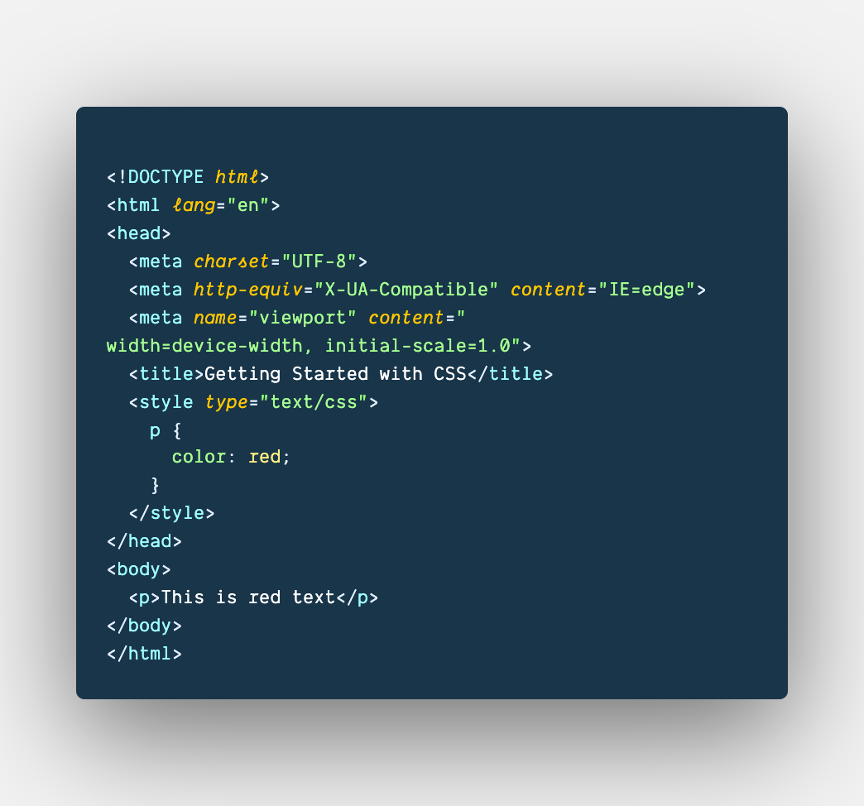
Inline Styles
Internal Styles
3 Ways To Add CSS To HTML
Uses the style attribute, comes with limitations.
Uses the <style> tag, should be used carefully.

Slide 42
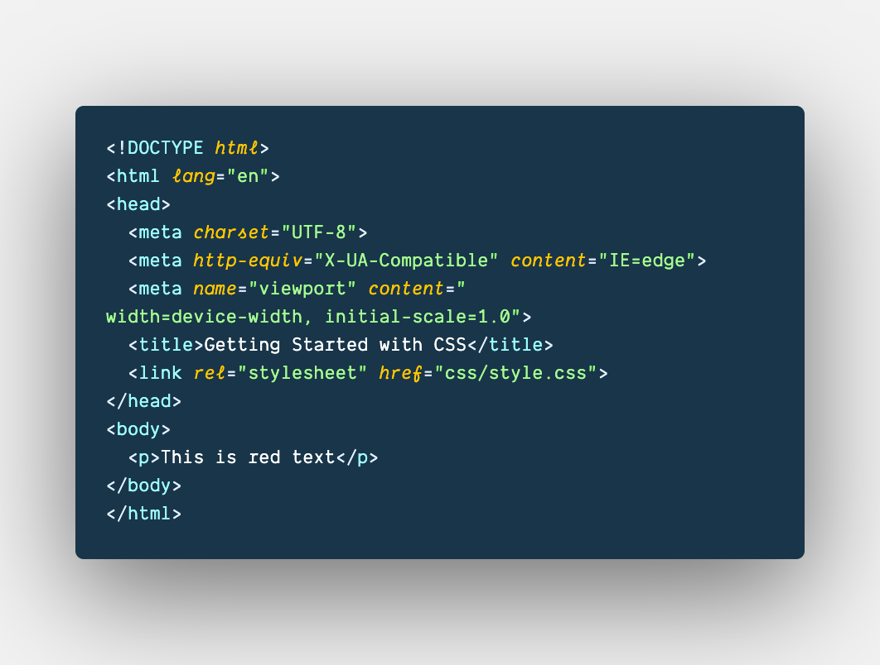
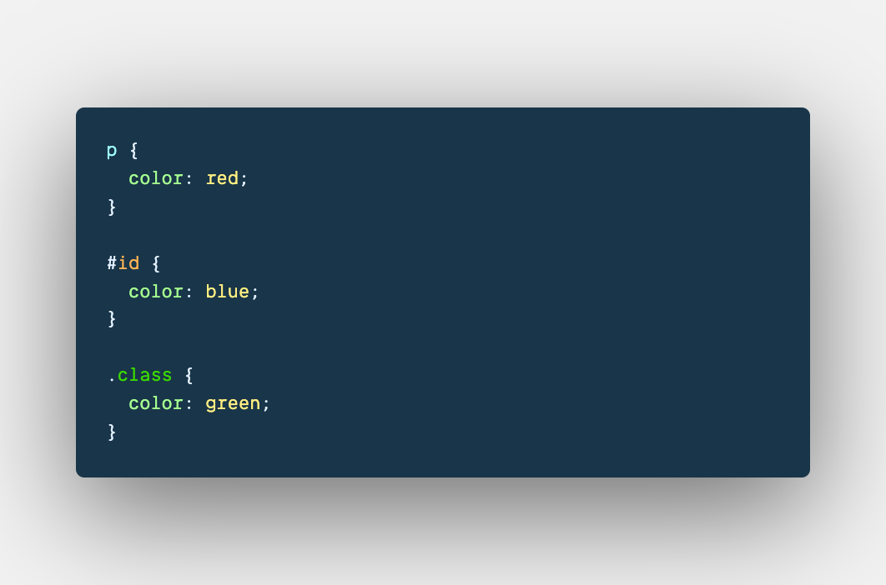
External Styles
3 Ways To Add CSS To HTML
Allows writing of css rules in an external stylesheet using the <link> tag.

Slide 43
Introduction to Frontend Engineering
Styling HTML Pages

Slide 44
Lets STYLE our HTML page
Introduction to Frontend Engineering
Let’s get our hands dirty with code.

Slide 45
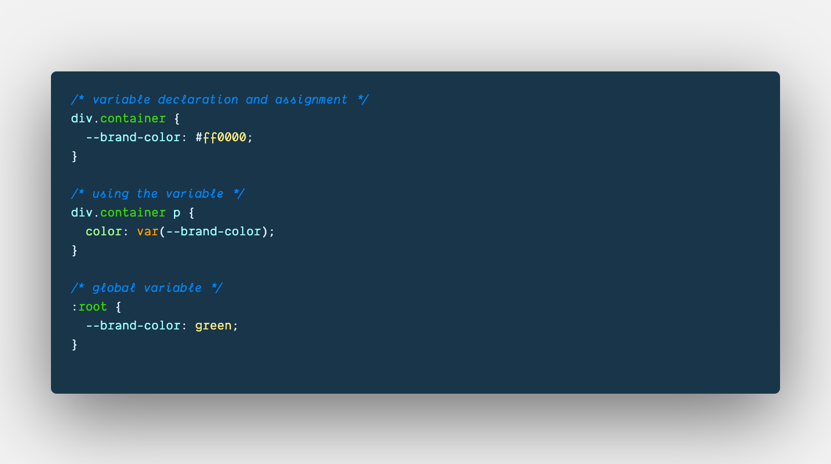
CSS Variables and Comments
Introduction to Frontend Engineering

Slide 46
Introduction to Frontend Engineering
CSS Selectors Game
Check out CSS Diner - https://flukeout.github.io/

Slide 47
Introduction to Frontend Engineering
Emmets

Slide 48
Writing CSS faster with Emmets
CSS Abbreviations
Value alias
Color values
Unit less values
Fuzzy search
Writing gradient with the help of emmets
Let stop here for now. For more information check the documentation.
Introduction to Frontend Engineering

Slide 49
Thank You!

